Slide 1


November 5th, 2019
Model Performance Output
Online Dashboard Visualization
Tool
Li Jin, PHD, PE, AICP

Slide 2
Outline
Data Driven Performance-based Planning and Programming
  Where we were?
  Goals and Objectives?
  How are we going to get there?
  How effective it is?
Travel Demand Models and Performance Measures
  Monitor and Predict Mobility and Congestion
Online Performance Measures Visualization Tool
Multiscale Performance Measurement
  Historical and Current Performance Measures for Mobility Trends
  Using Models for Predicting Future Performance Measures Analysis
Summary

Slide 3
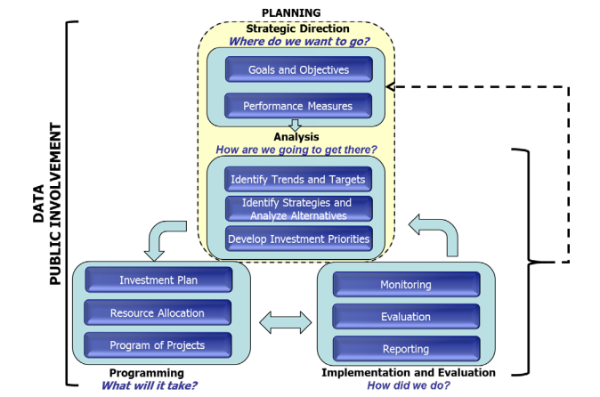
Data Driven Performance-based Planning and Programming
FHWA’s Framework for performance-based planning and programming
Source: Figure was copied from Performance Based Planning and Programming Guidebook, FHWA, 2013.

Slide 4
Travel Demand Model and Performance Measures
Travel Demand Model is a program or set of computer programs and data to forecast traffic flows on the transportation system.
Transportation analysis performance measures are quantitative estimates on the performance of a transportation facility, service, program, system, scenario or project with respect to policies, goals and objectives.
Notes:
Transportation analysis performance measures are about MOE. Some common MOEs used in traffic engineering include v/c ratio, level of service (LOS), crashes, vehicle delay, travel time, mode share and capacity. Performance measures can be based on empirical observations/data measurements of existing conditions or may be outputs of models that estimate or predict the performance of potential future scenarios or programs.

Slide 5
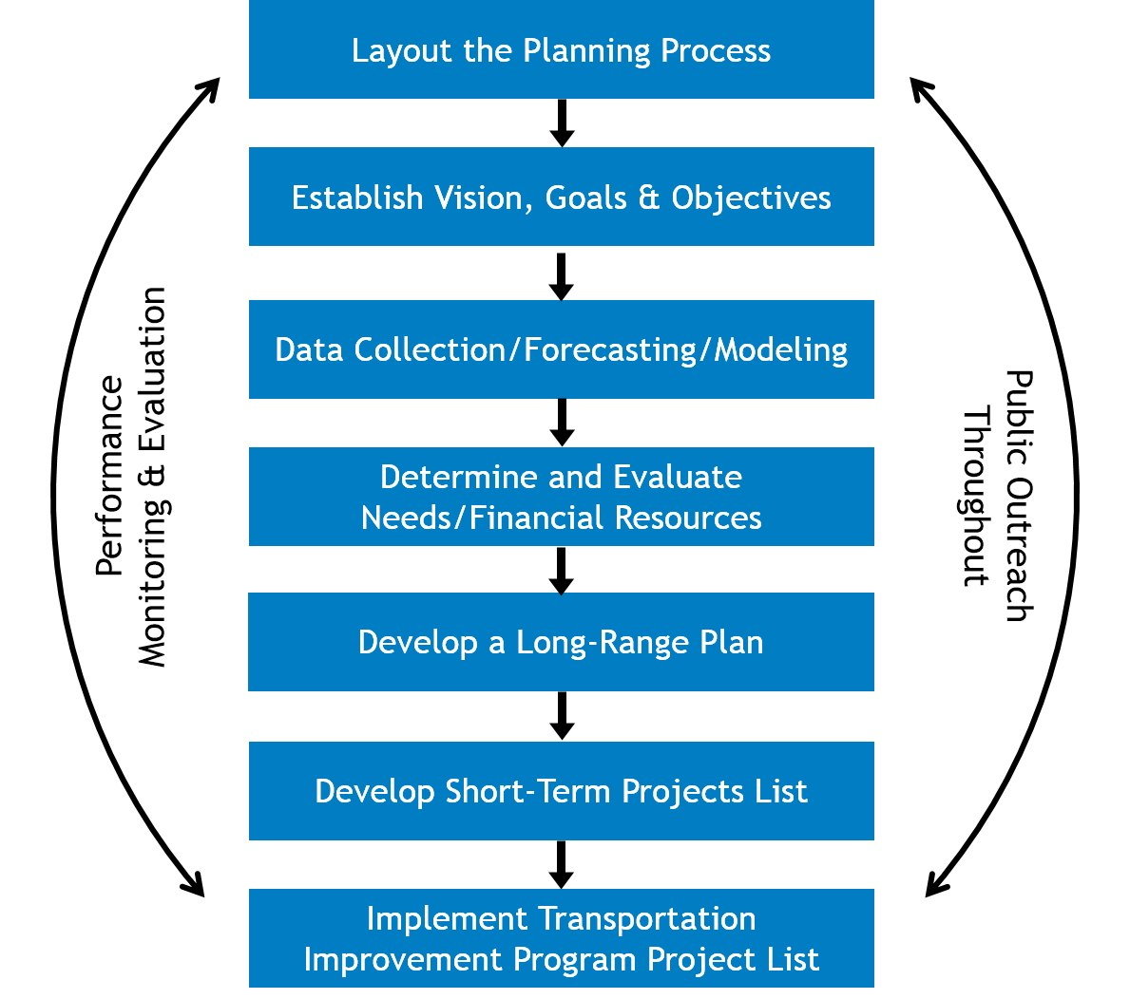
Travel Demand Model and Performance Measures
Source: Figure was copied from https://www.sjtpo.org/planning/.

Slide 6
Travel Demand Model and Performance Measures
Travel Demand Model main outputs:
  Traffic Volume
  V/C
  VMT
Performance Measures in following areas:
  Mobility
  Reliability
  Accessibility
  Safety
  Other Multimodal Performance Measures
  Infrastructure

Slide 7
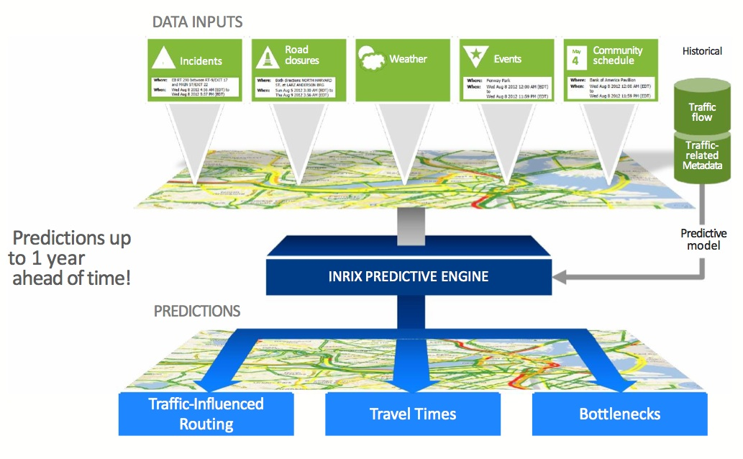
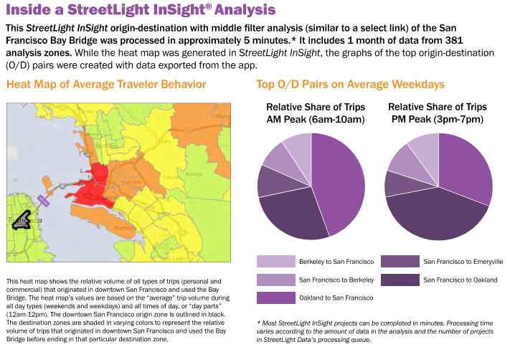
Travel Demand Model and Performance Measures
  Transportation data sources
  AADT Data
  Probe Speed Data
  O-D Data
  Roadway Data
  Model Output Data
  Census Data
Source: Figures were copied from Vendors.

Slide 8
Online Performance Measures Visualization Tool
Online accessible and GIS based
Better visualization of performance measures results
Could be developed for internal or external users
Interactive and customized website development
  For example, travel demand model outputs could be added and visualized.

Slide 9
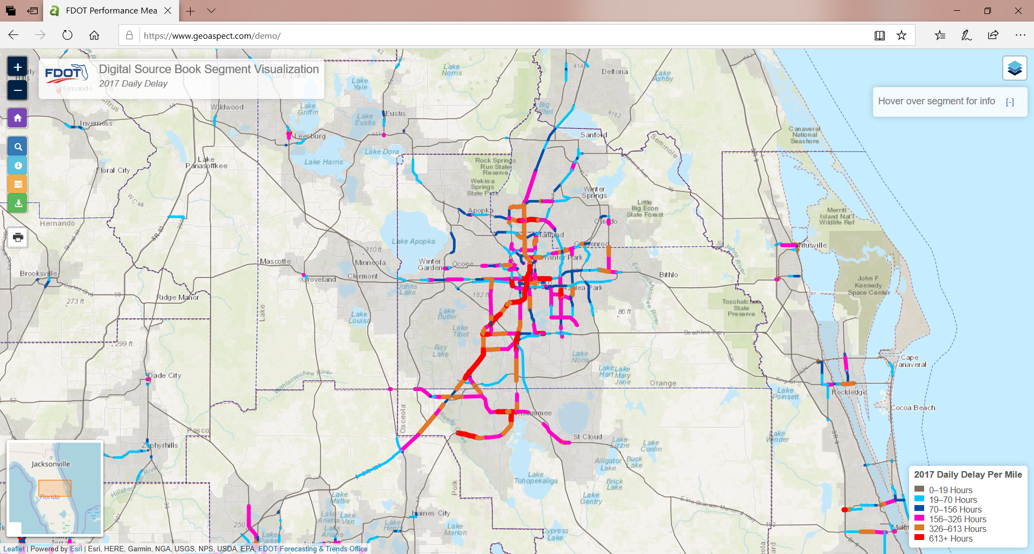
Online Performance Measures Visualization Tool

Slide 10
Online Performance Measures Visualization Tool (Demo)
Demo website:
  https://www.geoaspect.com/demo

Slide 11
Multiscale Performance Measurement
Performance measures could be reported on multiscale levels such as state, district, MPO, county, corridor or segment level.
For example: Vehicle Miles Traveled: https://public.tableau.com/profile/levon.mikaelian#!/vizhome/vmt_15706512488940/dashboard?publish=yes

Slide 12
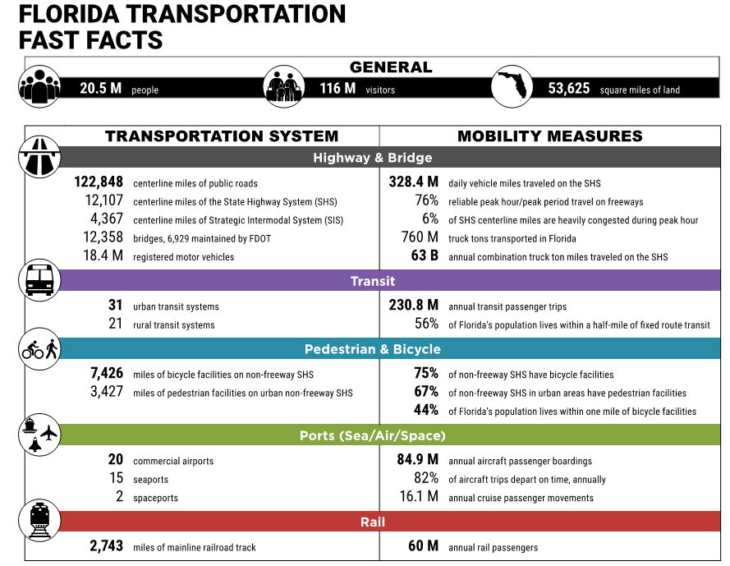
Historical and Current Performance Measures for Mobility Trends
Florida Statewide Level

Slide 13
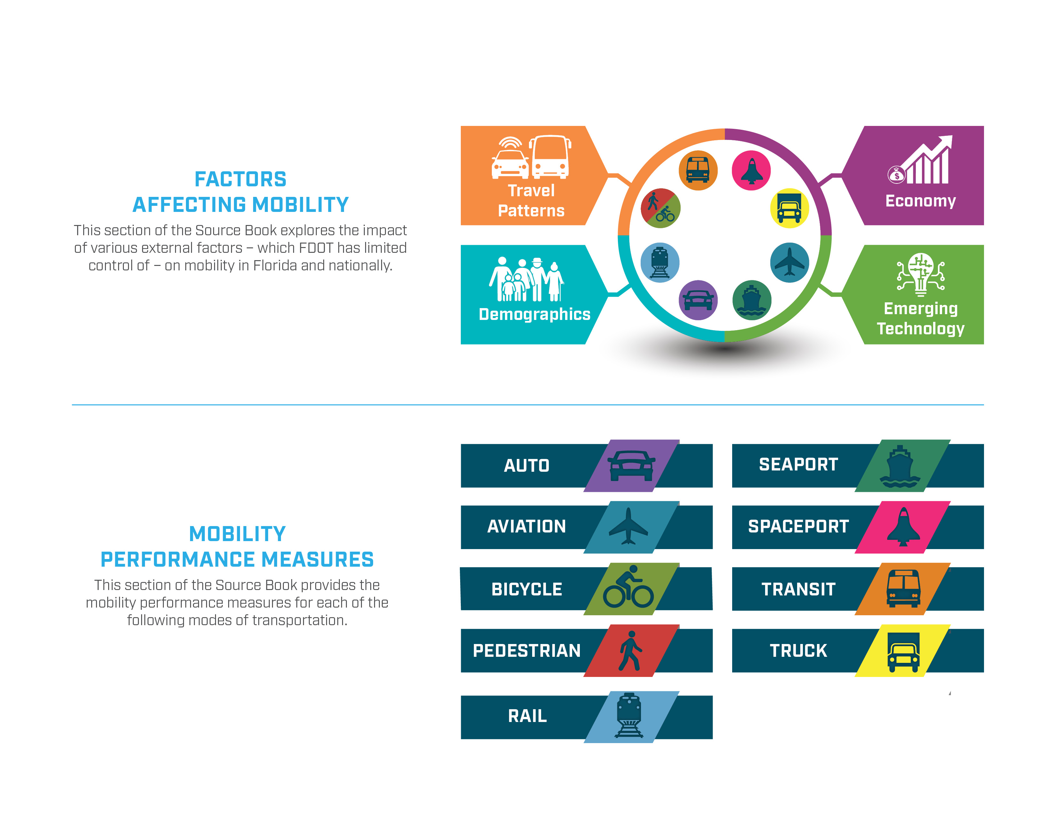
Historical and Current Performance Measures for Mobility Trends

Slide 14
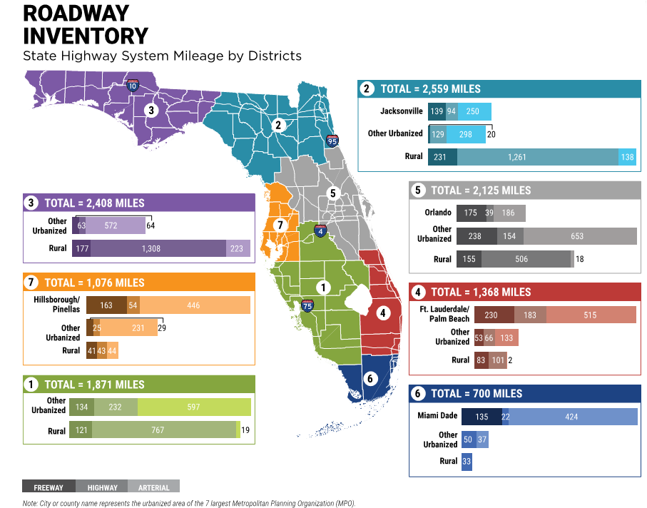
Historical and Current Performance Measures for Mobility Trends

Slide 15
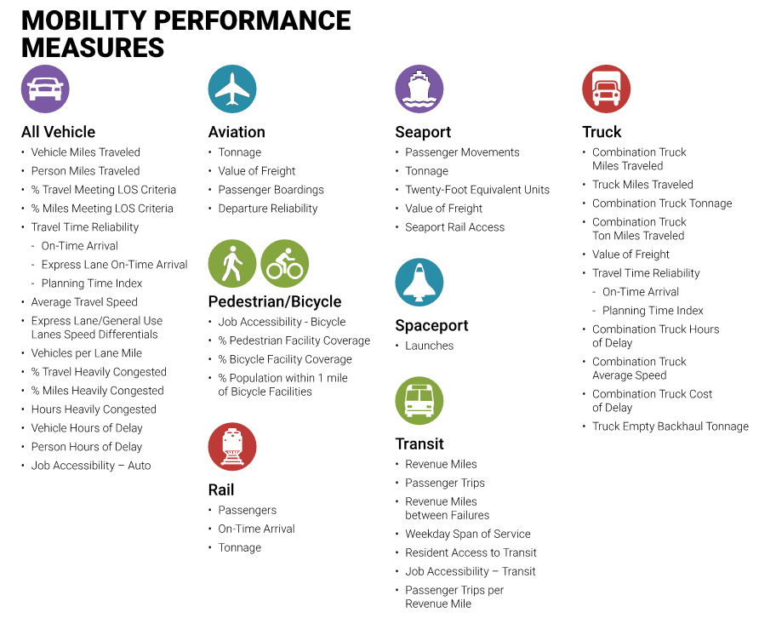

Slide 16
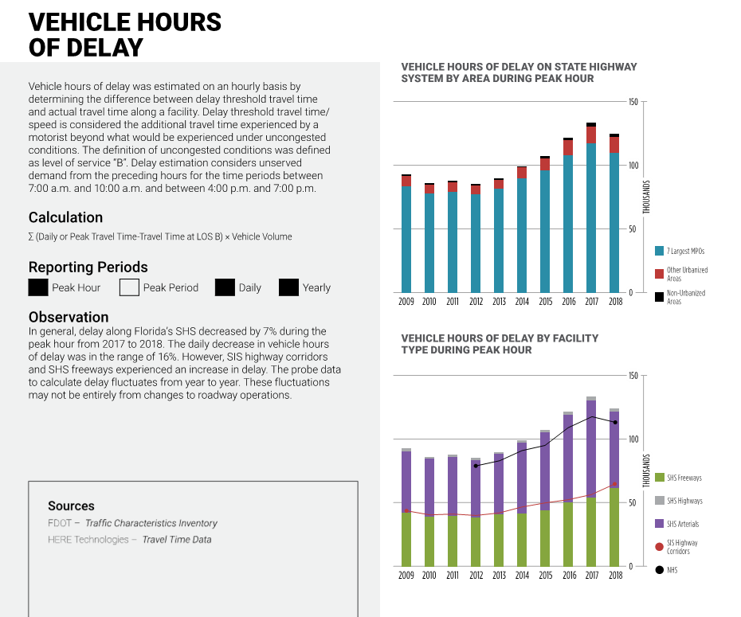

Slide 17
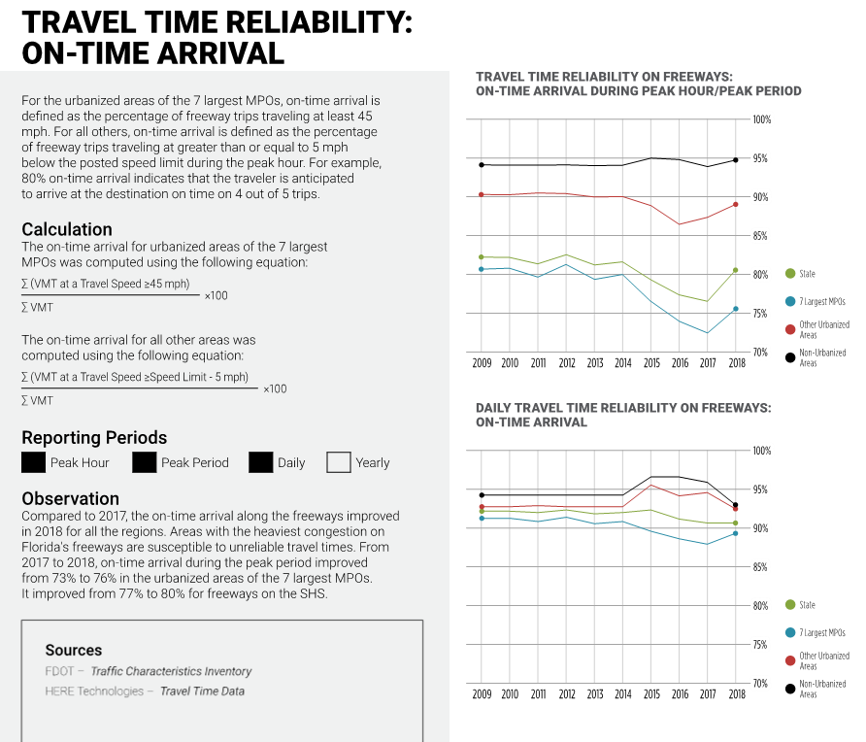

Slide 18
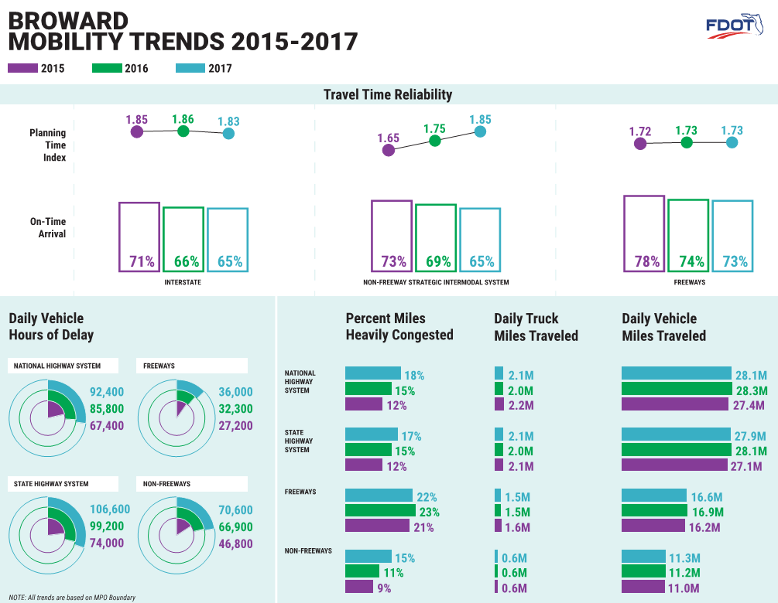
Performance Measures for MPOs

Slide 19
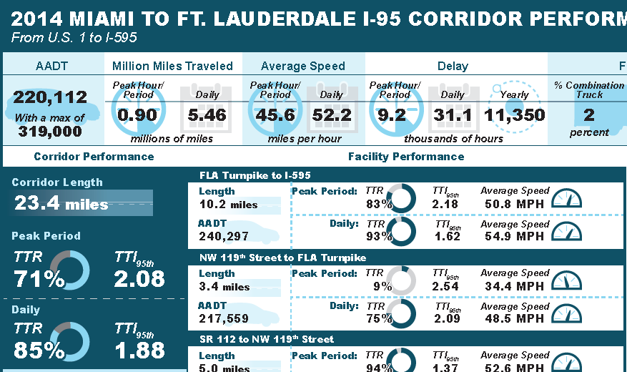
Performance Measures for Corridors
Notes:
We have a lot of data and measures that are not being accessed or used to their full potential.

Slide 20
Using Models for Predicting Future Performance Measures Analysis
  Forecast performance measures for increments of 5 and 10 years into the future.
  Assume no roadway characteristics changes

Slide 21
Using Models for Predicting Future Performance Measures Analysis
Volume projections
  Developed future traffic volume projections along segments of the State Highway System (SHS)
    2024 and 2029
    Three growth scenarios: high, medium, and low
  Methodology
    Collected Historical AADT from 2010 to 2018
    Segment volume projection by regression
      Low projections used logarithmic method
      Medium projections used linear method
      High projections used exponential method
    The projections were reviewed for reasonableness. Too high or too low projections were adjusted.

Slide 22
Using Models for Predicting Future Performance Measures Analysis

Slide 23
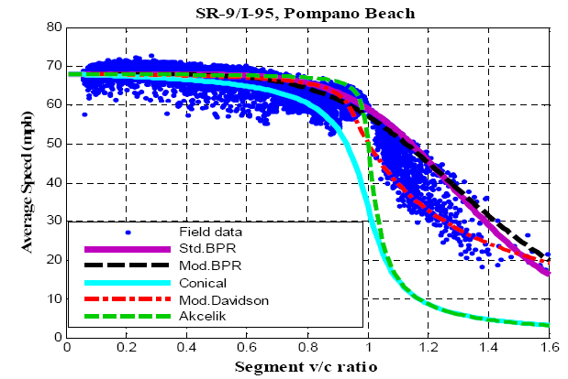
Using Models for Predicting Future Performance Measures Analysis

Slide 24
Using Models for Predicting Future Performance Measures Analysis
Basic Freeway Capacity (HCM 2016 Exhibit 12-7)
Multi-Lane highways (HCM 2016 Exhibit 12-8)

Slide 25
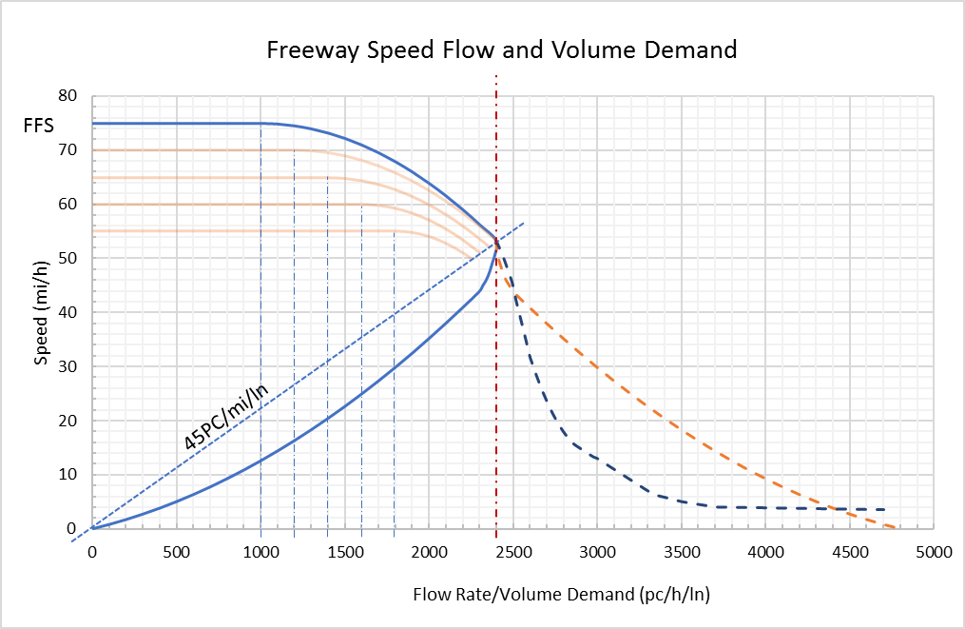
Using Models for Predicting Future Performance Measures Analysis

Slide 26
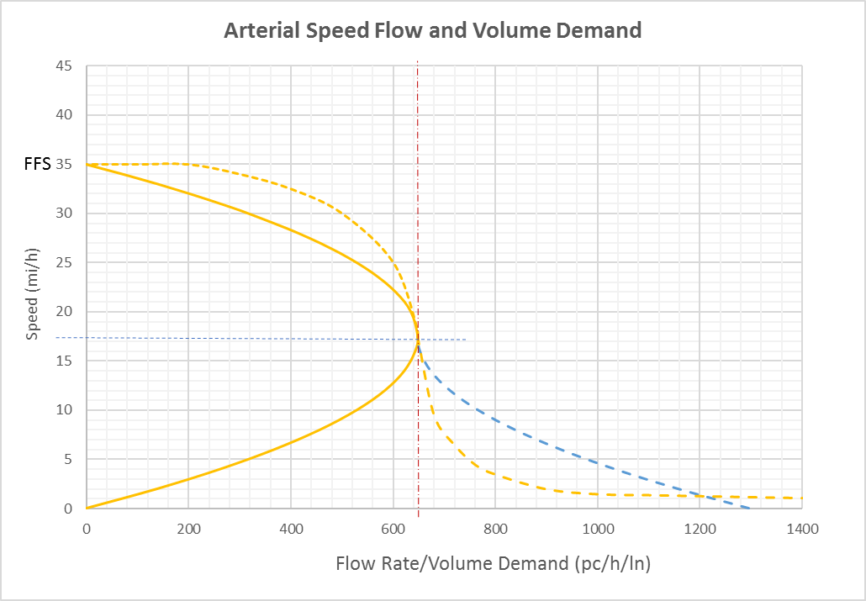
Using Models for Predicting Future Performance Measures Analysis

Slide 27
Using Models for Predicting Future Performance Measures Analysis
Using the volume projection data sets, performance measures based on modeled speeds were developed for
  2018 scenario
  2024 low, medium, and high scenarios
  2029 low, medium, and high scenarios
Growth rates for performance measures were developed between the 2018 and the 2024 horizon years for three scenarios using low, medium, and high projections.
Then the growth rates were applied to the 2018 Source Book performance measures using probe speeds, and then summarized into the tables/charts.

Slide 28
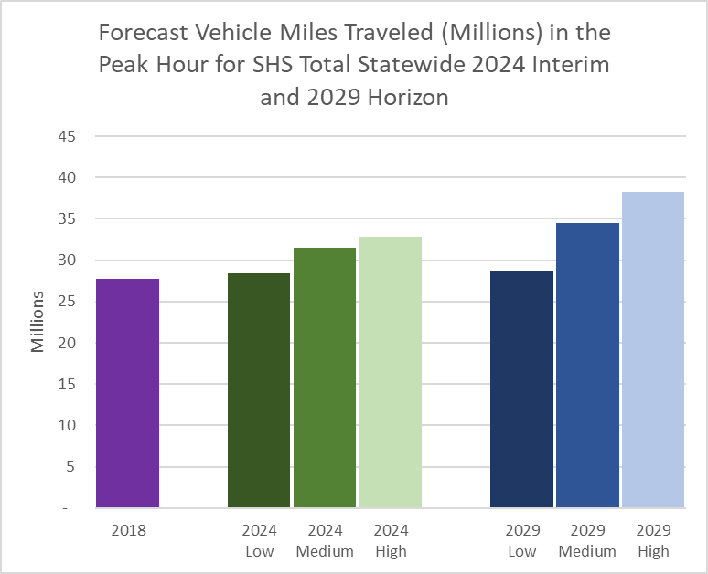
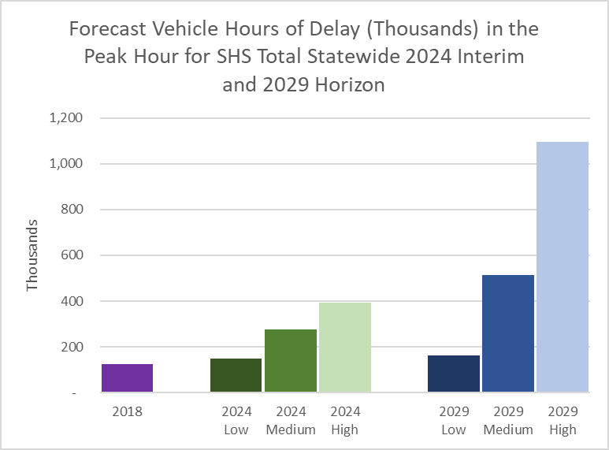
Using Models for Predicting Future Performance Measures Analysis

Slide 29
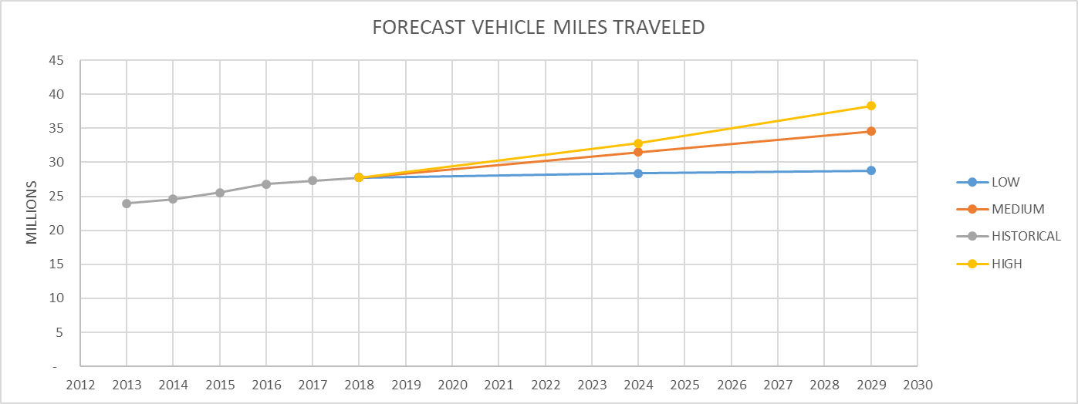
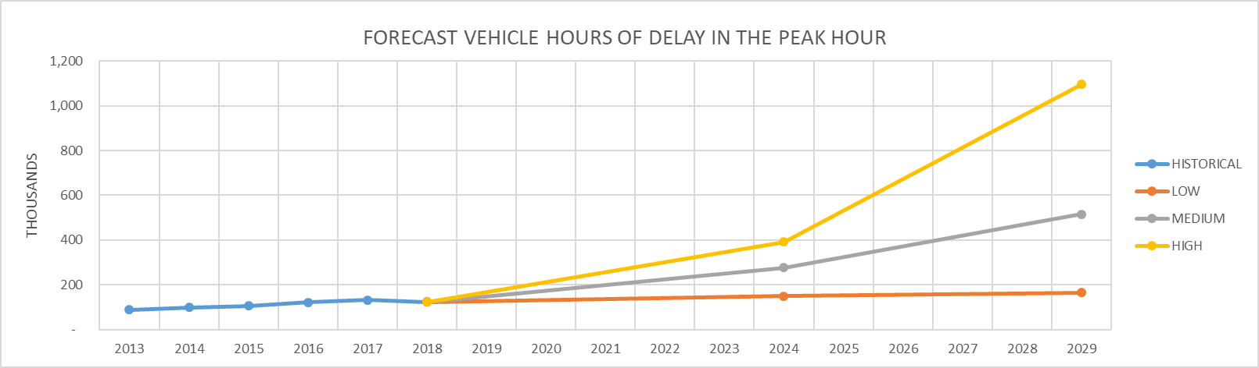

Slide 30
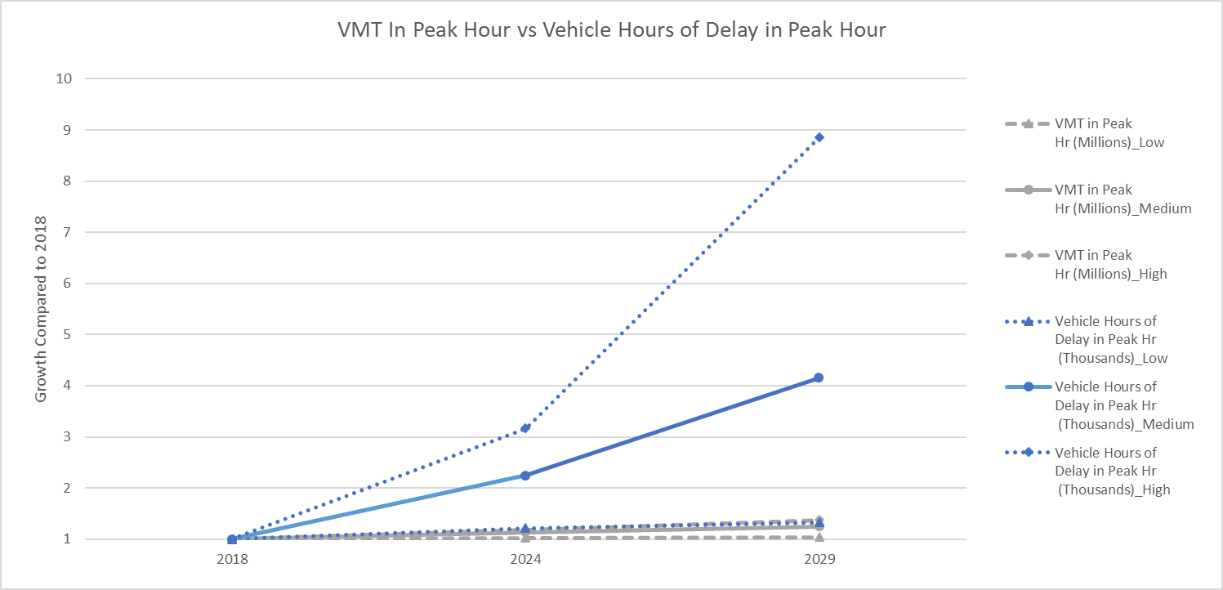
Using Models for Predicting Future Performance Measures Analysis

Slide 31




Summary
Monitor
Performance
Quantify
Decisions
Achieve
Goals
Improve
Outcomes

Slide 32

THANK YOU!

